Slide 1

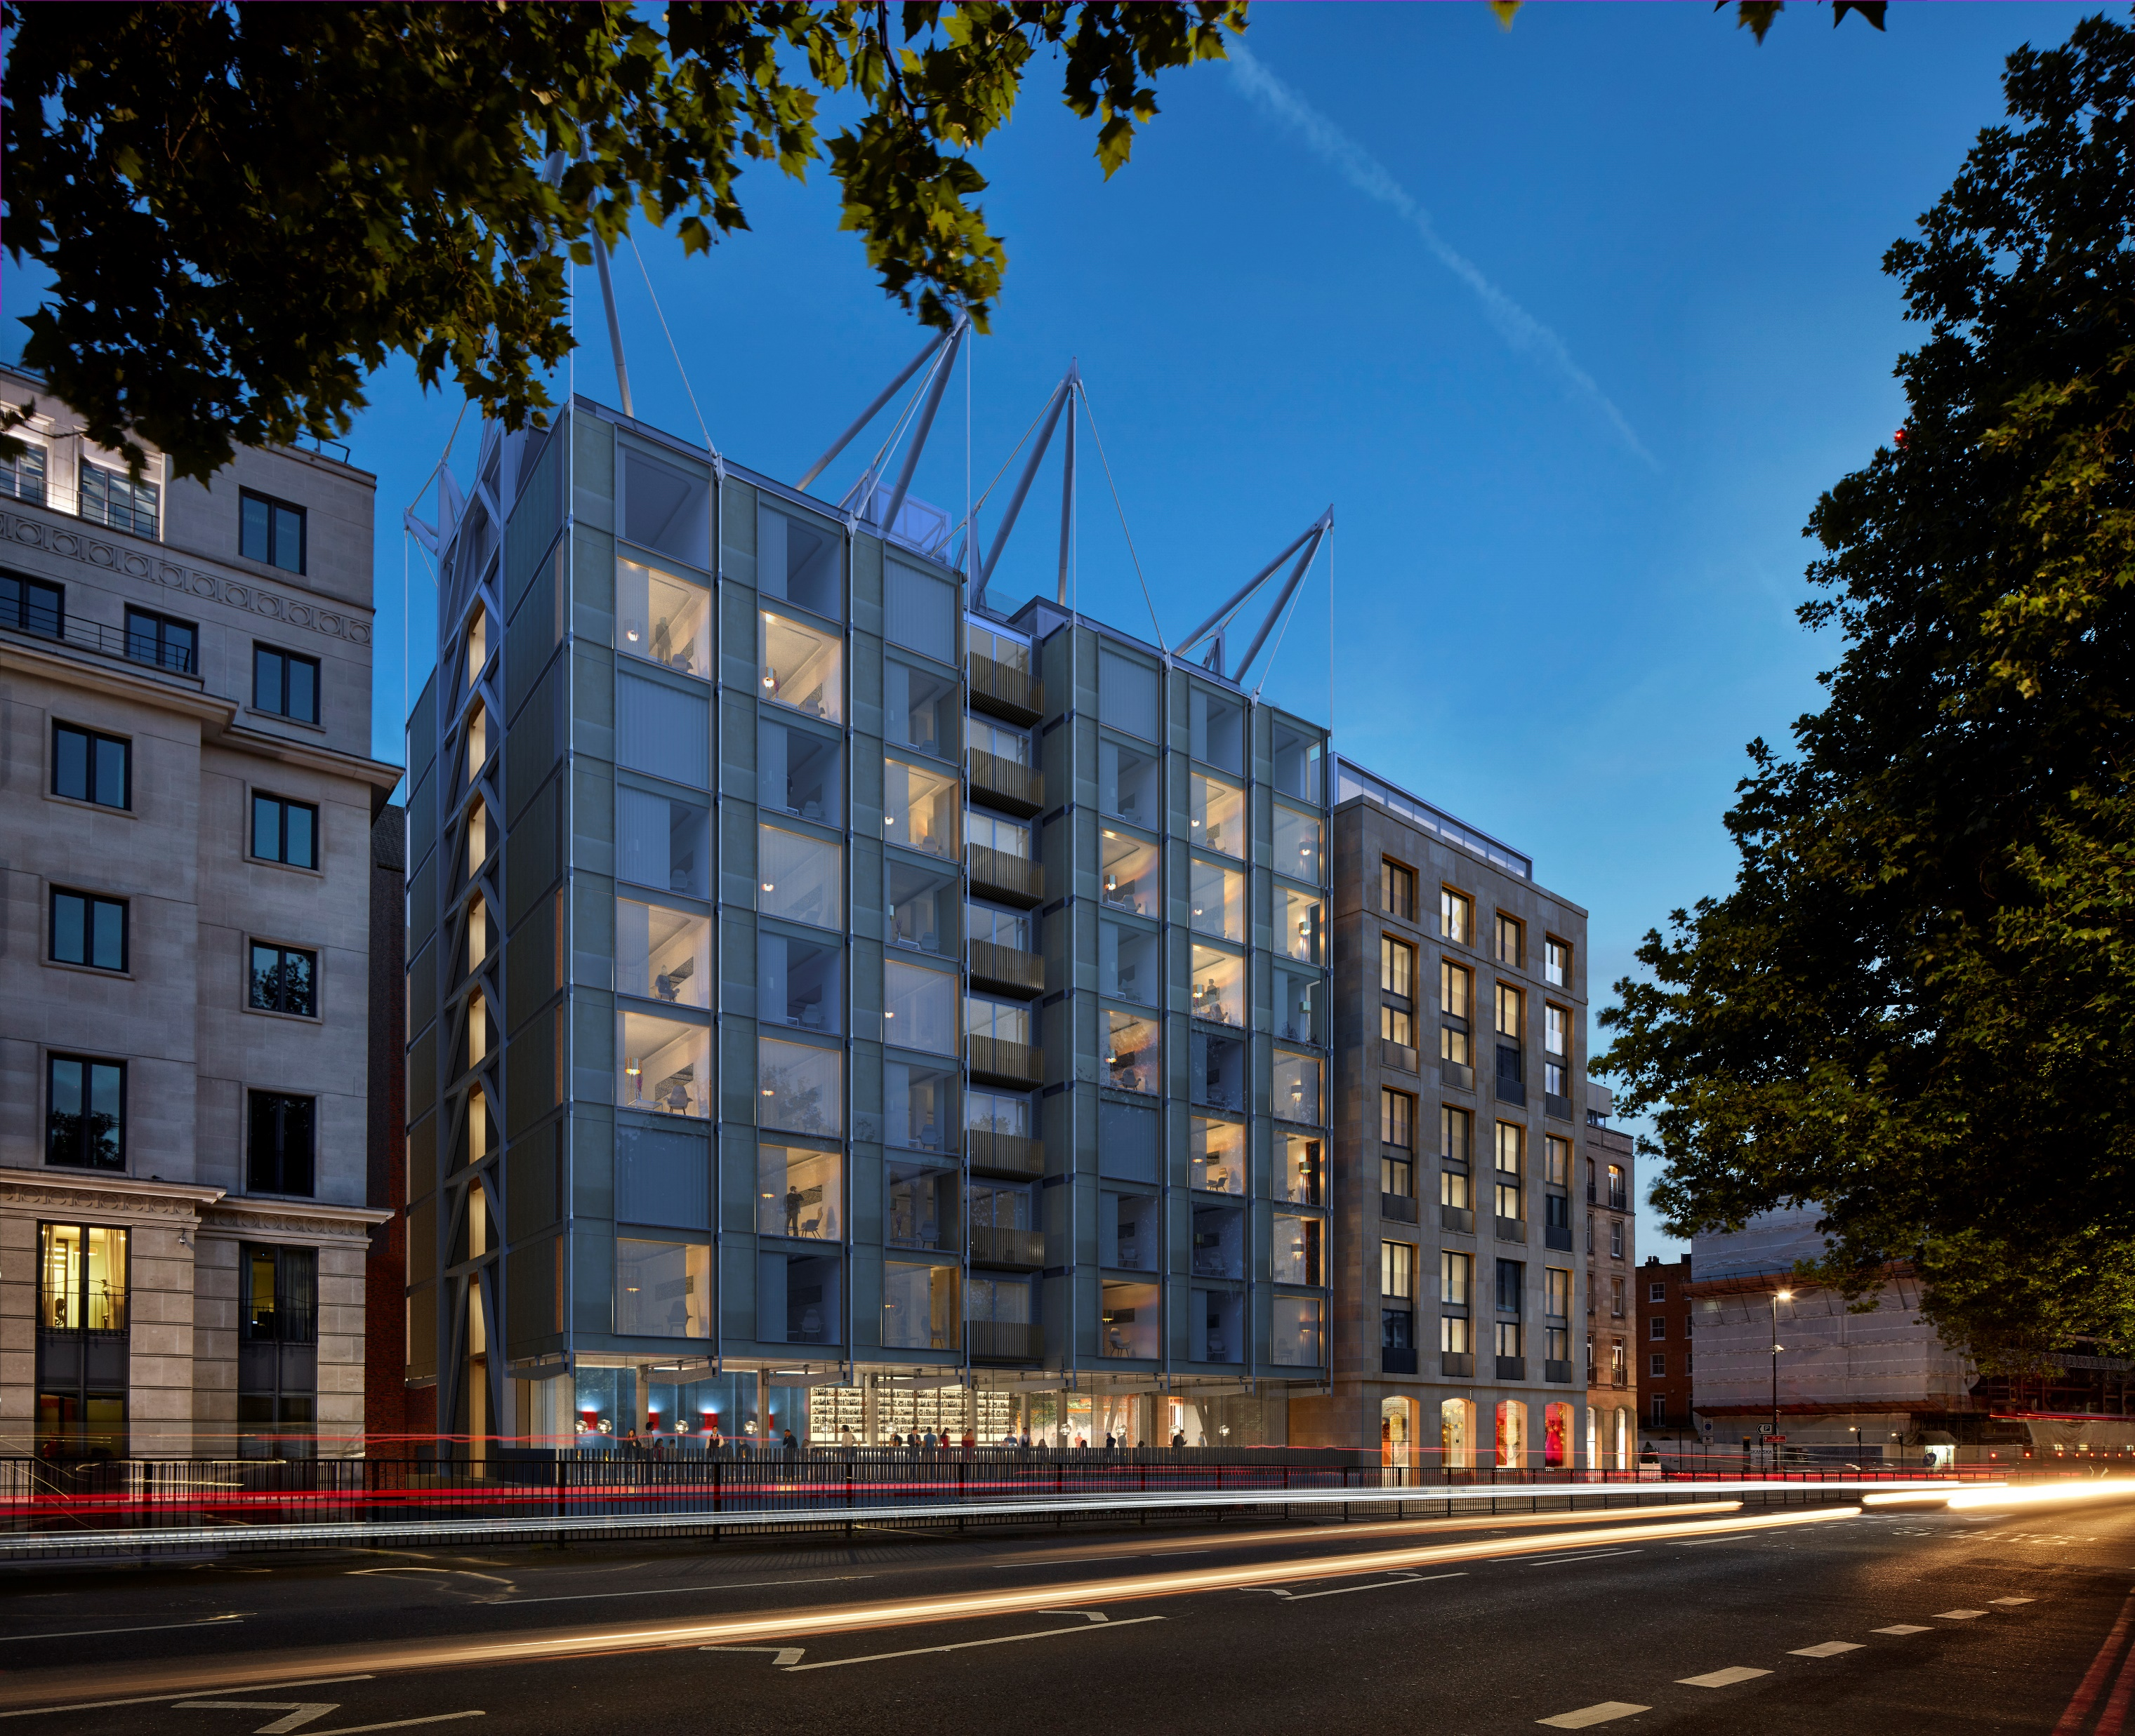
Background: CANVAS #FDFBF7, no boxes
THE EMORY LOGO
Text: LAMP BLACK #020301
Background: CANVAS #FDFBF7
Dear Mr/Mrs,
We are so pleased you've chosen The Emory for your upcoming stay in London, and you'll find all your reservation detailsbelow. Everyone here will ensure you love every moment of your stay.
confirmation details
Text: LAMP BLACK #020301,
Text font: Founders Grotesk
Text size: 10
Text size: 13.5
Lines: SERPENTINE #180EC2

Slide 2



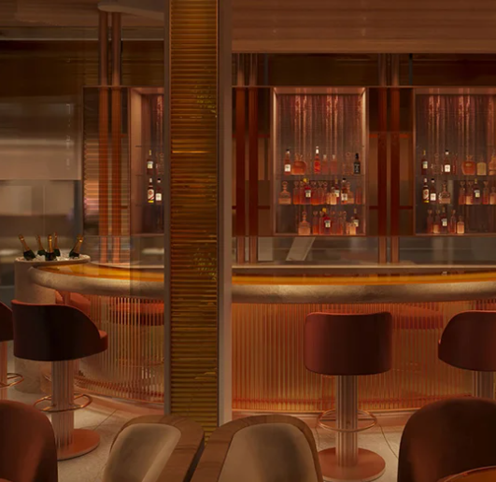
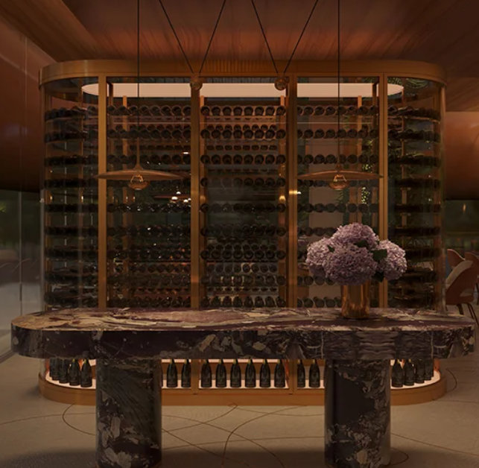
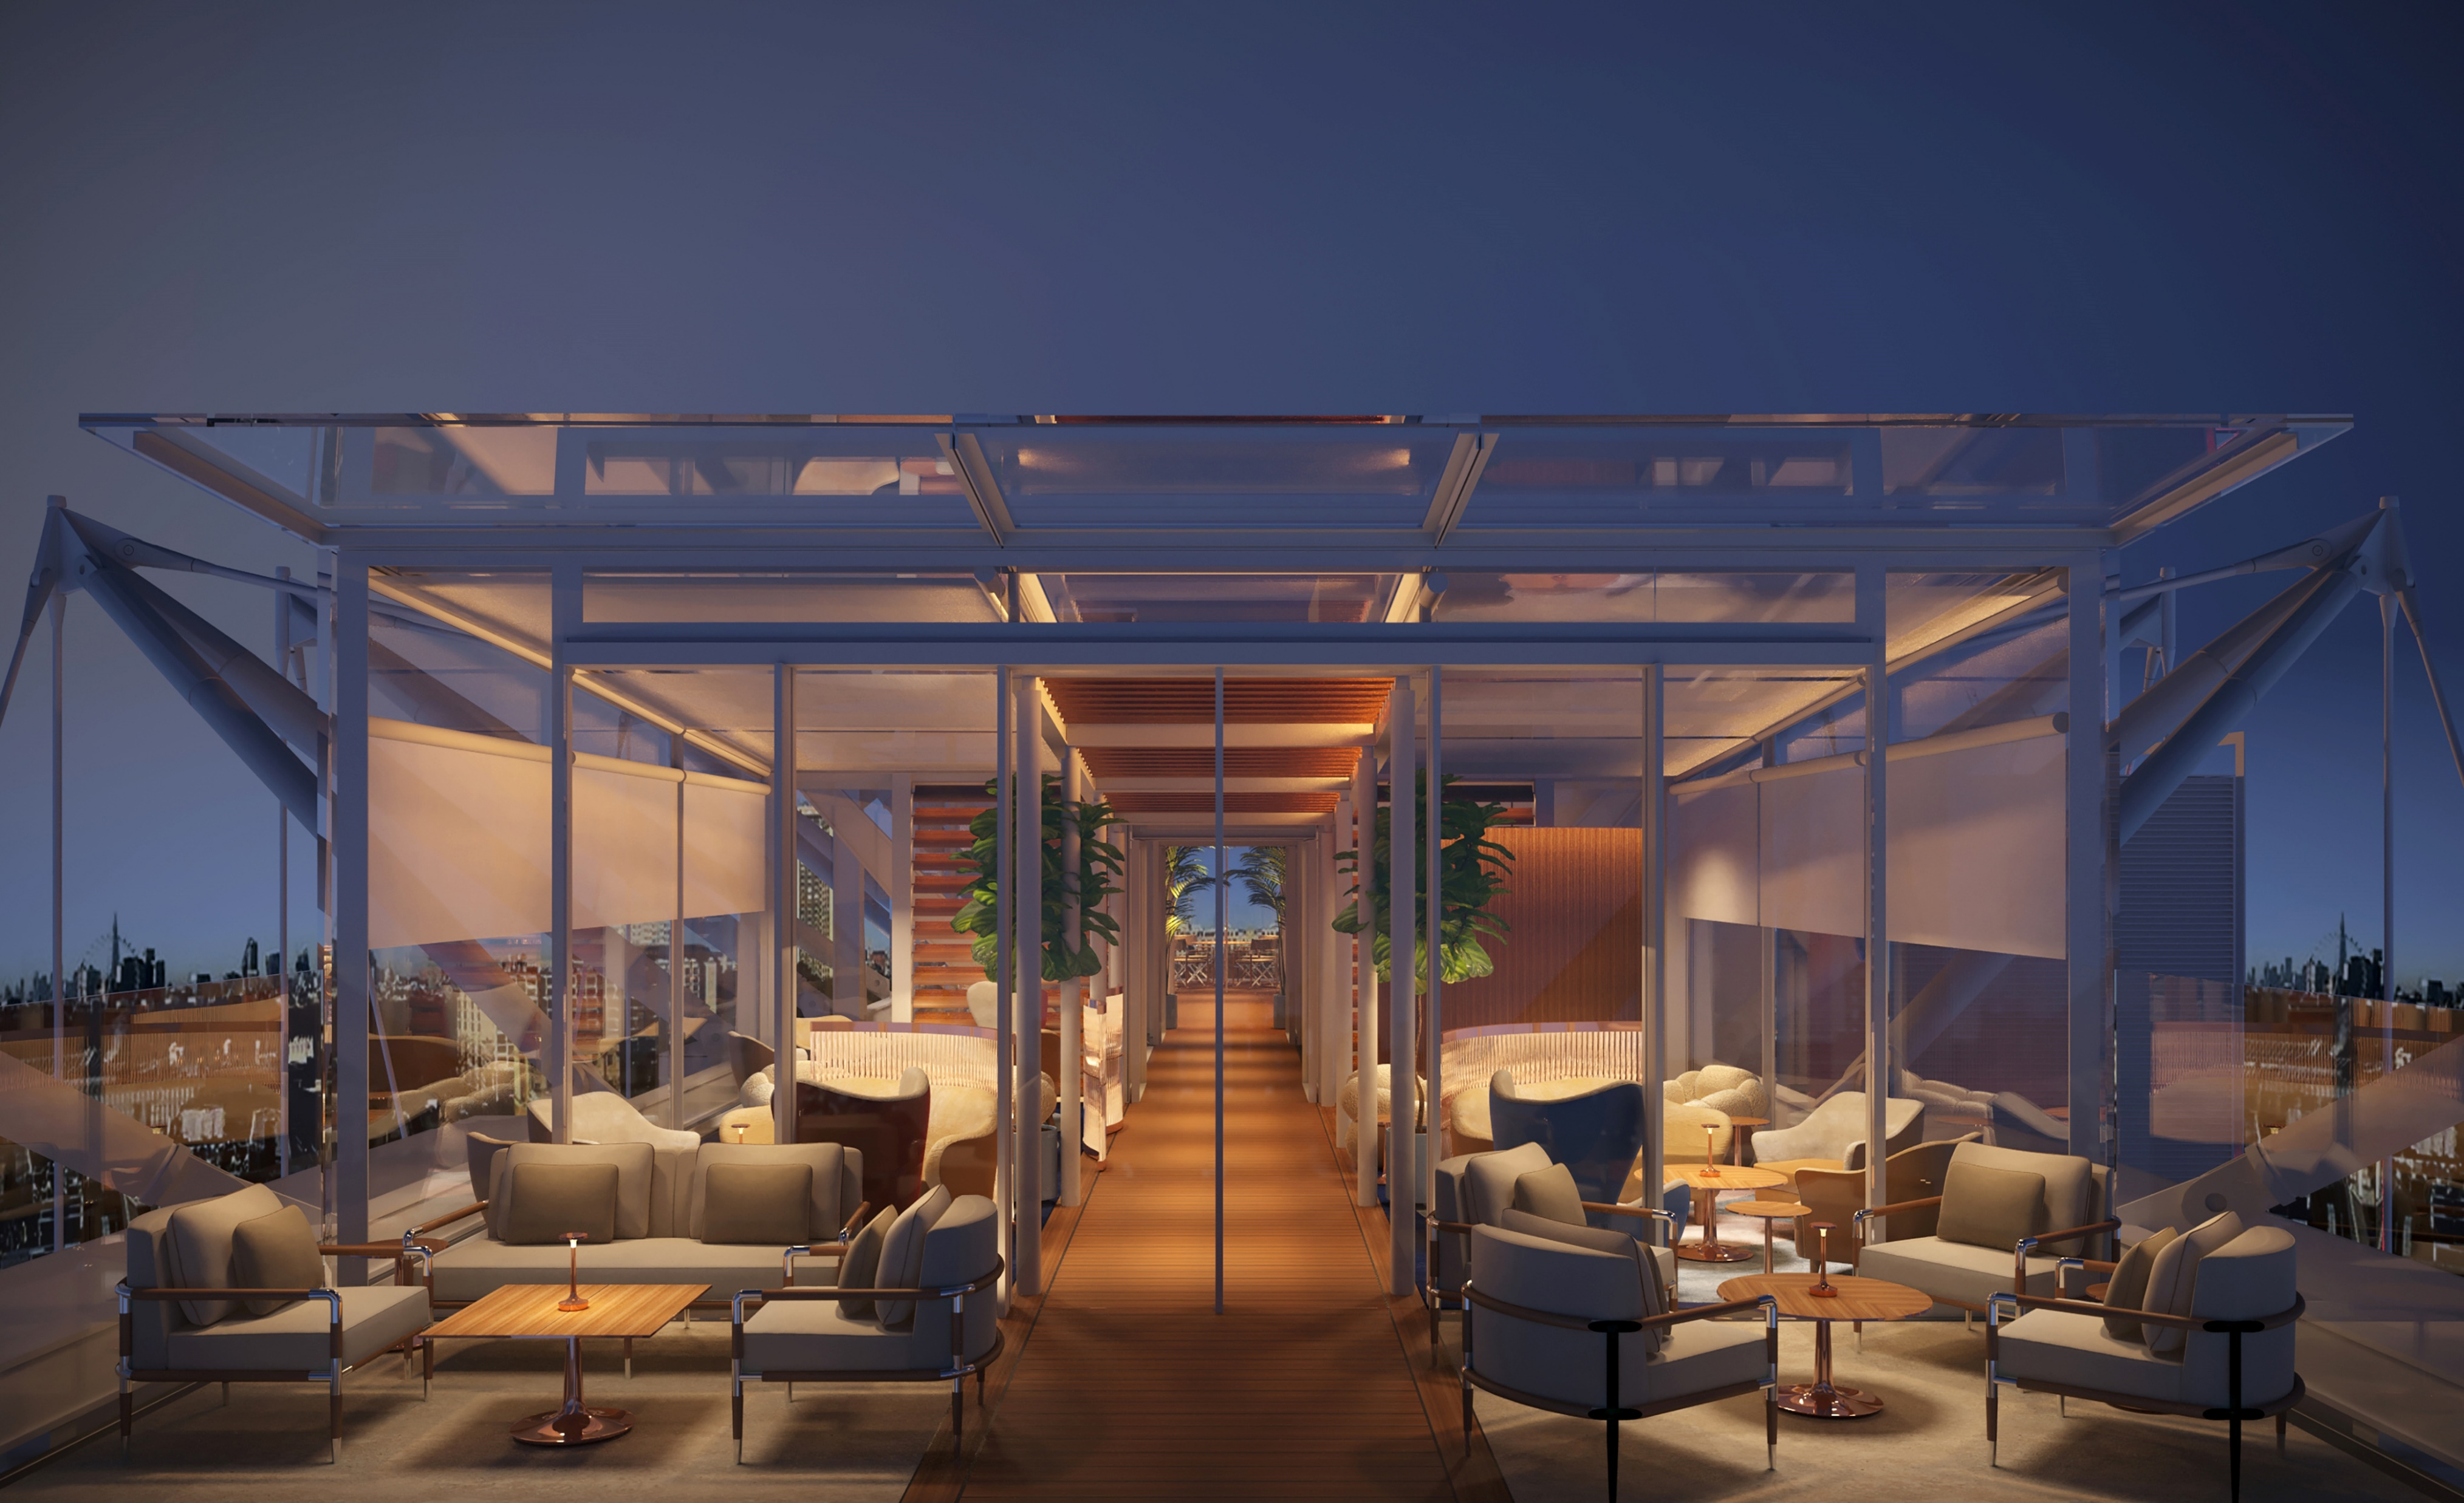
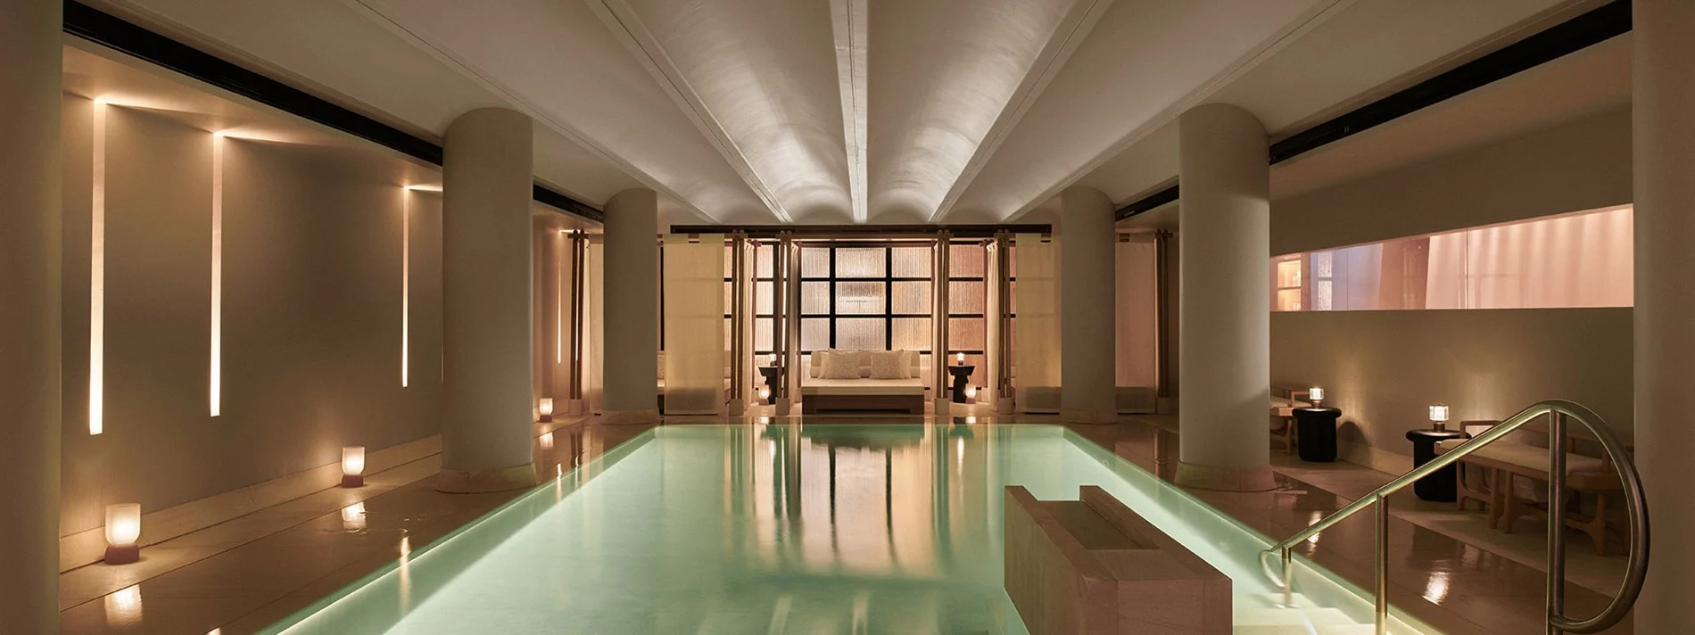

ENHANCE YOUR STAY
CROSS-SELLING BOXES
Text: TITANIUM WHITE #FFFFFF
Boxes: LAMP BLACK #020301
Background: CANVAS #FDFBF7, no box
ABC
ABOUT THE HOTEL
ROOFTOP BAR
SURRENNE
Box: SERPENTINE #180EC2
Text: TITANIUM WHITE #FFFFFF
BOOK
Following the confirmation of your reservation, we will never ask you to reveal your personal information, including credit card details.
We look forward to welcoming you to The Emory and will do our utmost to ensure you have an enjoyable stay with us. Please do not hesitate to contact me if I can further assist.
Kind regards,
The Reservations Team
The Emory
The Emory, Old Barrack Yard, Belgravia, London, SW1X 7NP
Reservations Number
Main Number
FOOTER
Text: TITANIUM WHITE #FFFFFF
Background: LAMP BLACK #020301

